Slide 1
DSCI-531: FAIRNESS IN ARTIFICIAL INTELLIGENCE BIASES IN TEXT EMBEDDINGS
Kristina Lerman
Spring 2025

Slide 2
Is it possible to discriminate through text and language?
AI promised to eliminate human bias from decisions
… but algorithms are only as good as the data they were trained on
Data reflects explicit prejudices …
… implicit biases in society
… patterns of discrimination, exclusion and inequality
“Unthinking reliance on data mining can deny historically disadvantaged and vulnerable groups full participation in society”
[Barocas, S., & Selbst, A. D. (2016). Big data's disparate impact. Calif. L. Rev., 104, 671.]

Slide 3
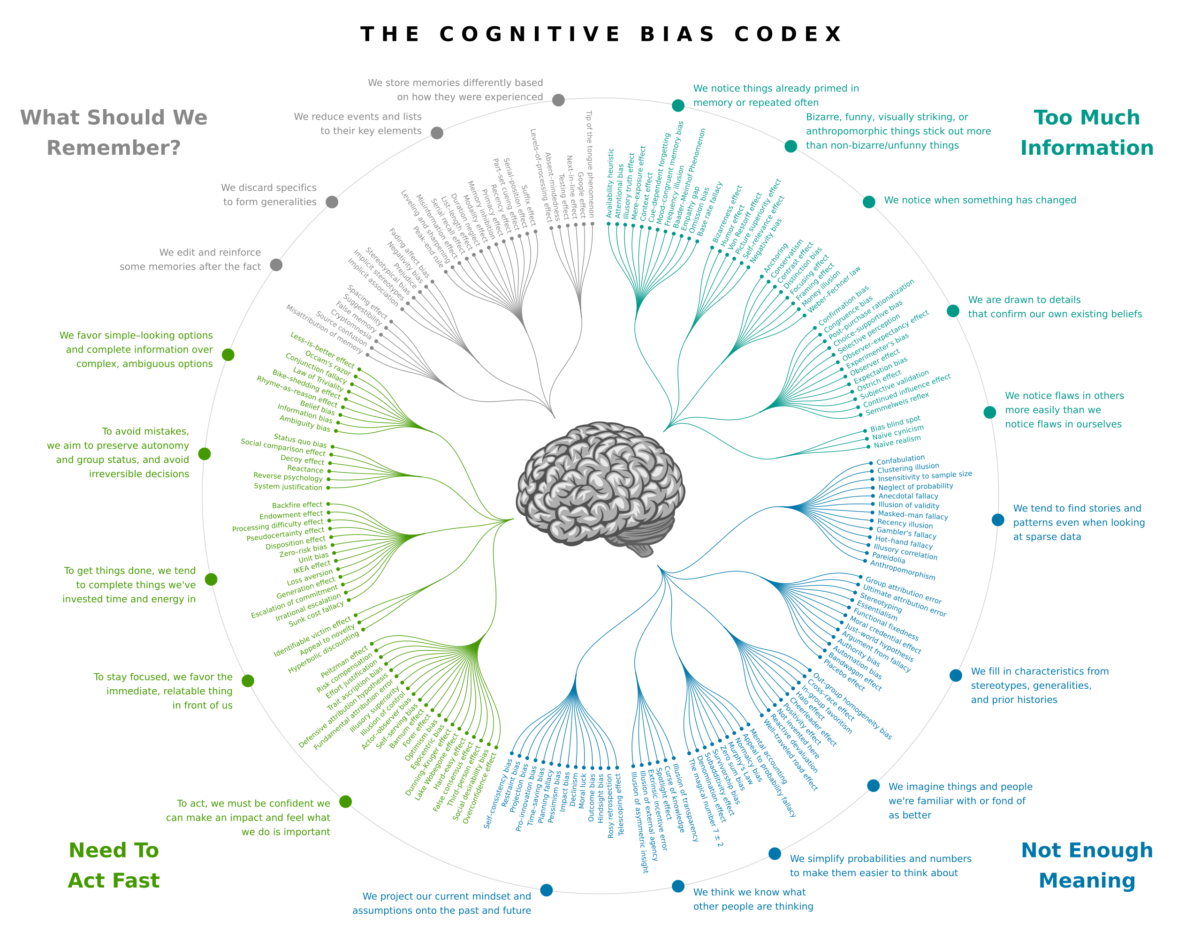
Bias is all around us
Human brain evolved a number of adaptations to uncertain, dynamic world
Negativity bias: we pay more attention to negative information than to positive information
Loss aversion: we fear loss more than we value gain
In-group bias: we favor people from our own tribe
Availability heuristic: we judge the likelihood of events by how easily they come to mind
Cultural & social biases (e.g., stereotypes) can be learned

Slide 4
Prejudice: Explicit and implicit bias
prej·u·dice
preconceived opinion (usually negative) that is not based on reason or actual experience.
Explicit bias
the person is aware of their feelings and attitudes, and intentional in behaviors; Characterized by prejudice expressed through physical and verbal actions. E.g., “Women who are mothers are not serious about their research.”
Implicit bias
Learned attitudes or stereotypes that exist in our subconscious and can involuntarily affect the way we think and act. E.g., Not inviting female researchers into research collaborations.”
Other types of stereotypes: age, body image, accent, …
These biases are imprinted in our society, including in language.
How do we identify/measure biases
How do we mitigate biases

Slide 5
A father and son get in a car crash and are rushed to the hospital.
The father dies.
The boy is taken to the operating room and the surgeon says,
“I can’t operate on this boy, because he’s my son.” Can you explain why?
https://www.youtube.com/watch?v=J69HkKz9g4A
2

Slide 6
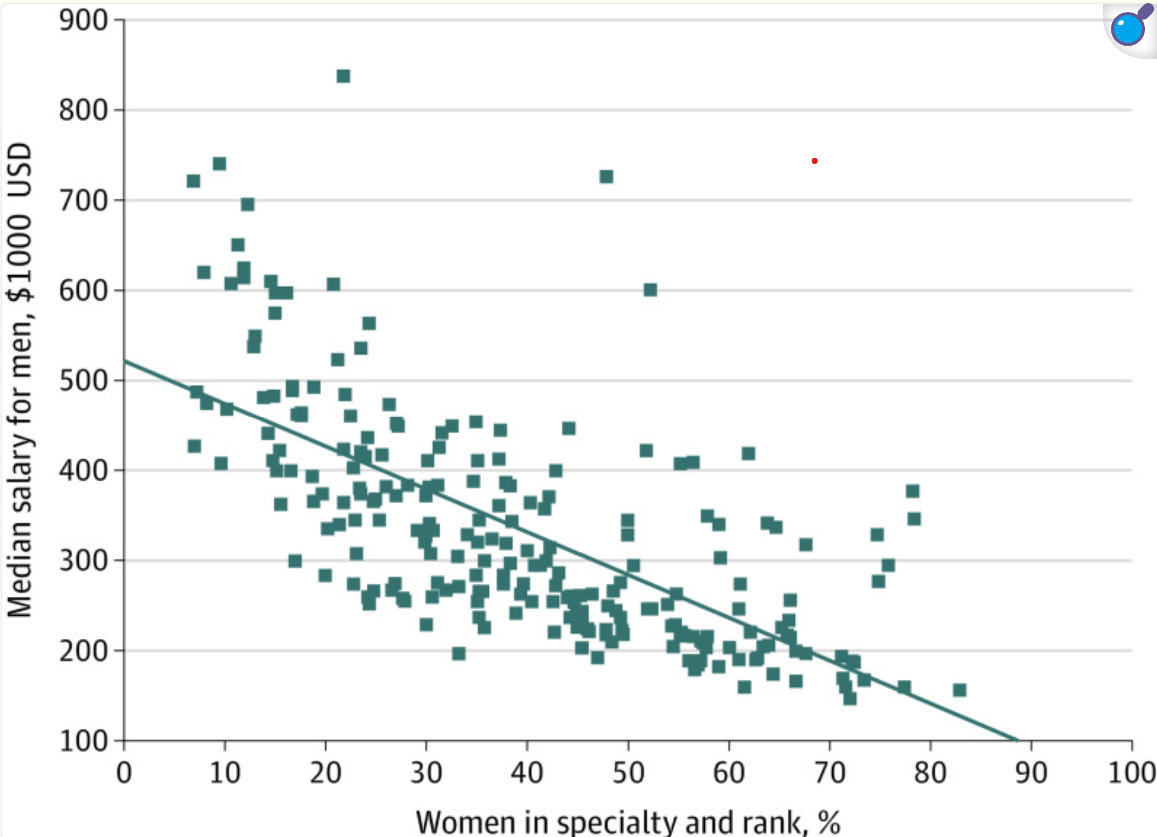
Gender pay disparity in medicine
For every 10% increase in the percentage of women in a medical specialty, there was a corresponding decrease in median salaries for both men and women. Specifically, men's median salaries decreased by $7,465, while women's median salaries decreased by $15,003.
Women are overrepresented in lower-paying specialties such as pediatrics and family medicine, while men dominate higher-paying fields like orthopedic surgery and cardiology.

Slide 7
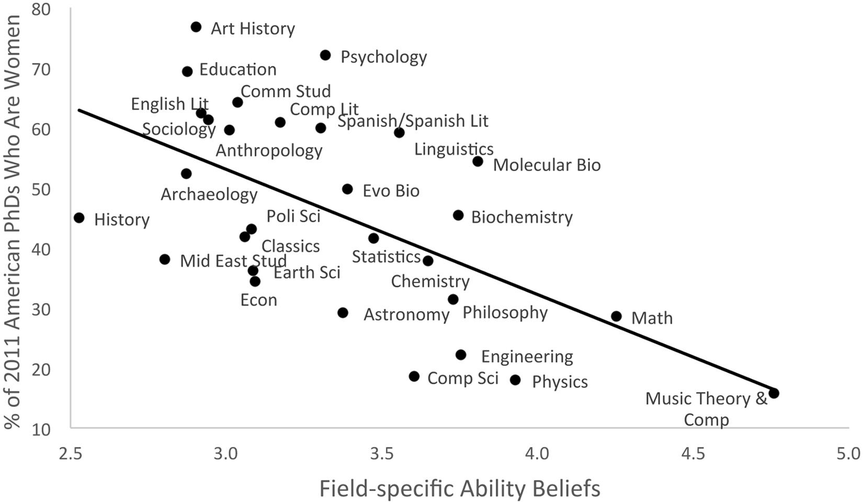
Women are underrepresented in fields where success is believed to require brilliance
Fields emphasizing the need for raw, innate talent—such as physics, mathematics, and philosophy—had lower representations of women and African Americans. In contrast, disciplines that valued hard work and dedication over inherent brilliance tended to be more diverse.
Meyer, M., Cimpian, A., & Leslie, S. J. (2015). Women are underrepresented in fields where success is believed to require brilliance. Frontiers in psychology, 6, 235.

Slide 8
What are some of the consequences of bias?
Harms
Perpetuates inequity. E.g., gender bias in healthcare resulted in women’s health conditions receiving less attention and treatment.
AI may create a feedback loops that keep bias going
Affect decision making e.g., hiring discriminates against women
Lack of income parity
Harm product quality
“Benefits”
Beneficial to the other group
Targeted marketing
Greater social cohesion

Slide 9
Language & Bias
Language implicitly transmits ingroup/outgroup identify information, leading to human prejudices
Language models (e.g., word embeddings) encode stereotyped biases in addition to other knowledge, including how flowers are pleasant and the gender distribution of occupations.
Behavior can be driven by cultural history embedded in language, and can vary between languages.
Creating a feedback loop
Bias enters data in other ways, e.g., demographics, test scores, …

Slide 10

Which words come to mind? - Flowers

Slide 11
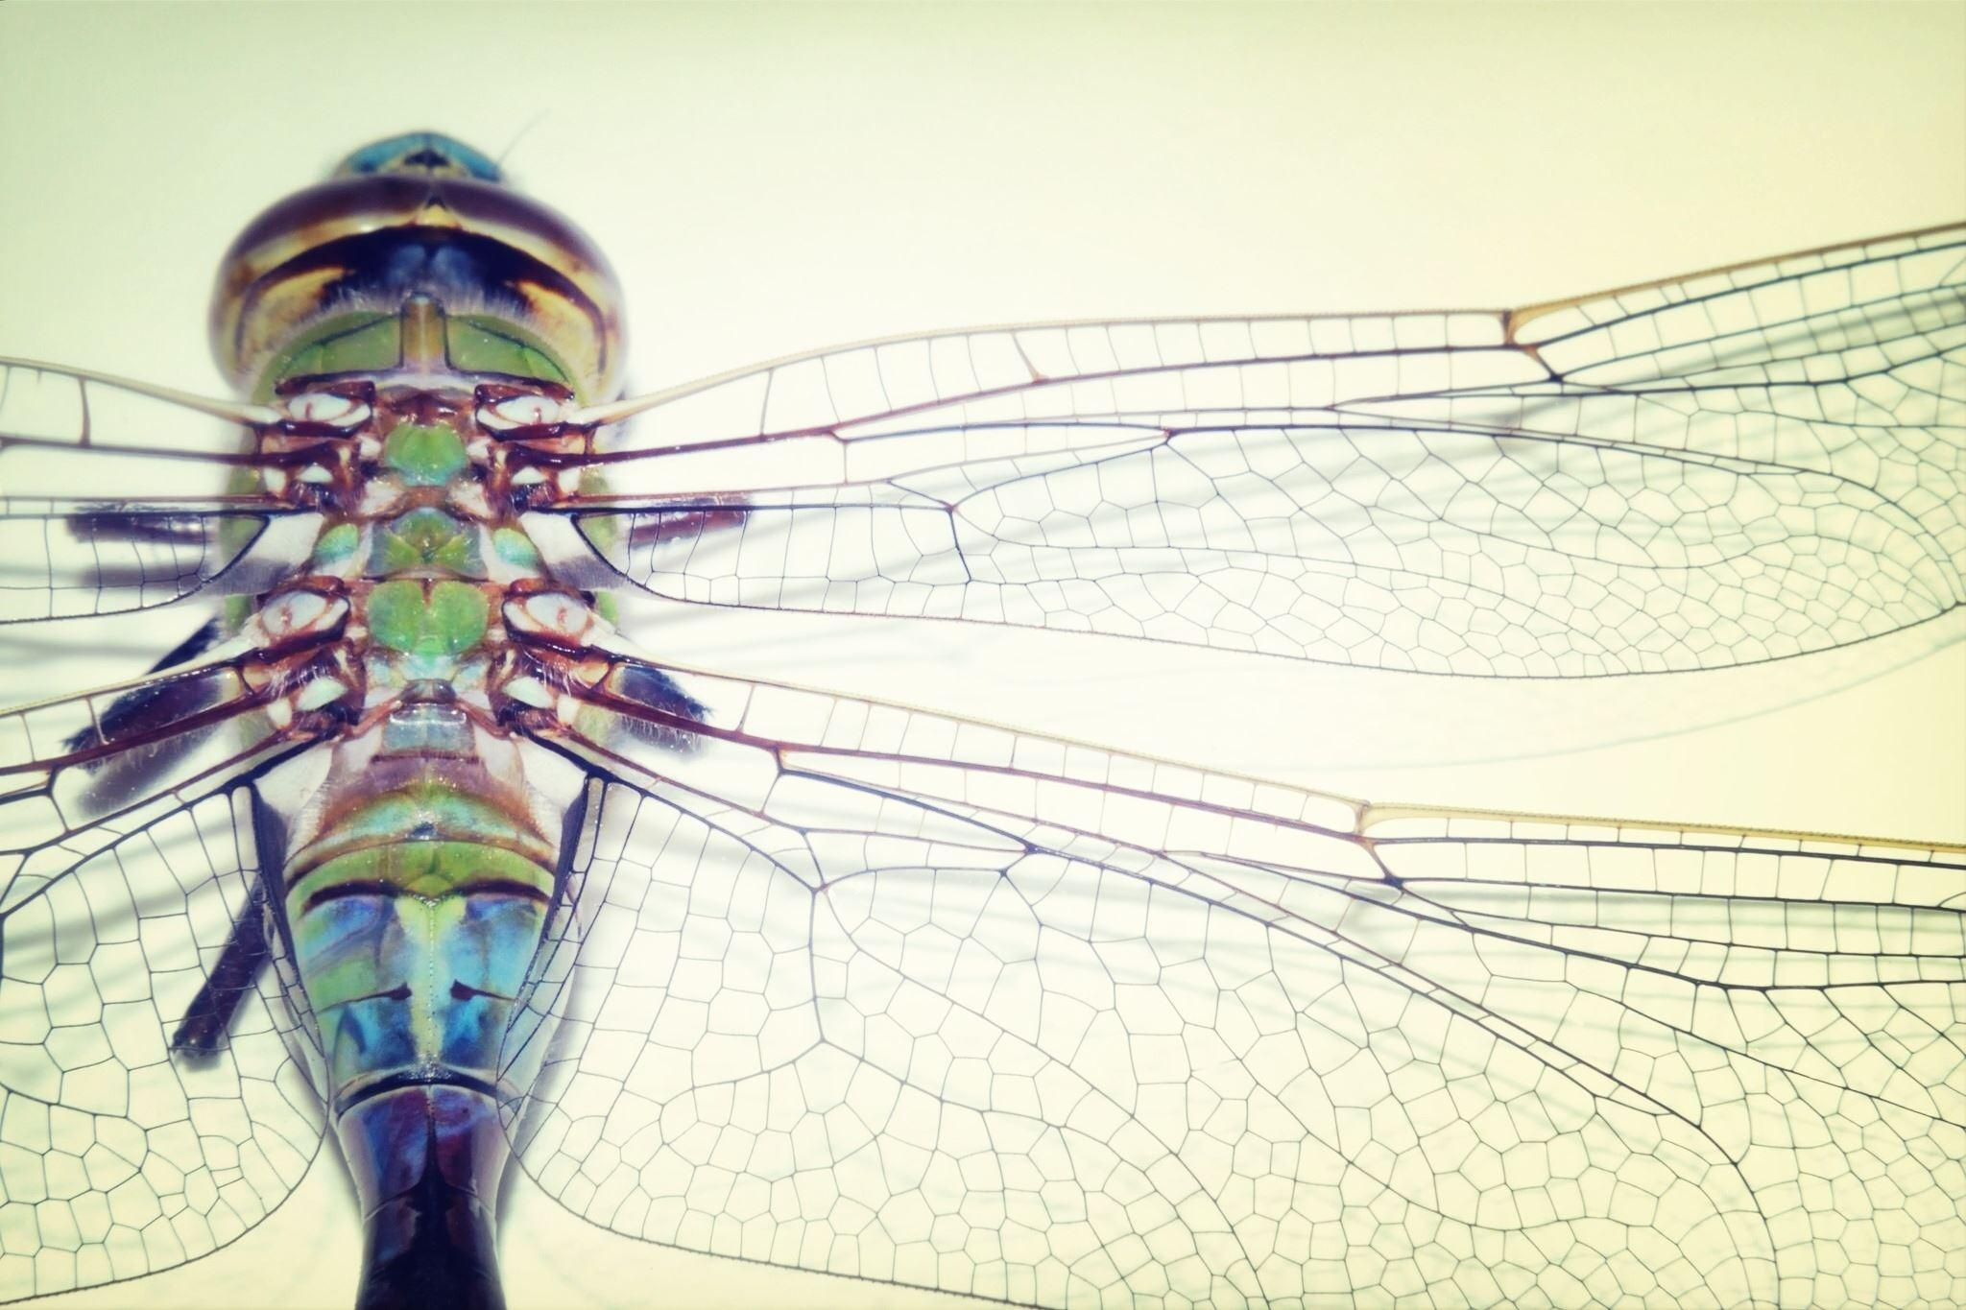
Which words come to mind? - Insects

Slide 12
Implicit association test (IAT)
Implicit Association Test (IAT) used by psychologists to measure implicit prejudices and stereotypes
IAT measures differences in response times when subjects are asked to pair two concepts they find similar, in contrast to two concepts they find different.
Response times are faster when tasks are easier: e.g., subjects are much quicker if they are told to label insects as unpleasant and flowers as pleasant than if they are asked to label these objects in reverse

Slide 13
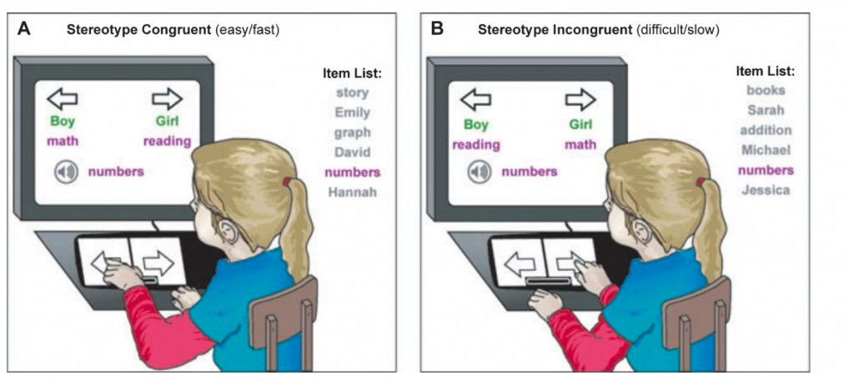
Implicit association test (IAT)
https://implicit.harvard.edu/implicit/

Slide 14
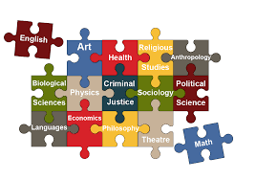



It is easier (quicker) to associate some concepts together than others
Liberal arts
Liberal arts
vs

Slide 15
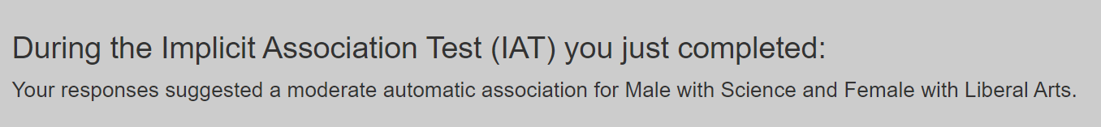
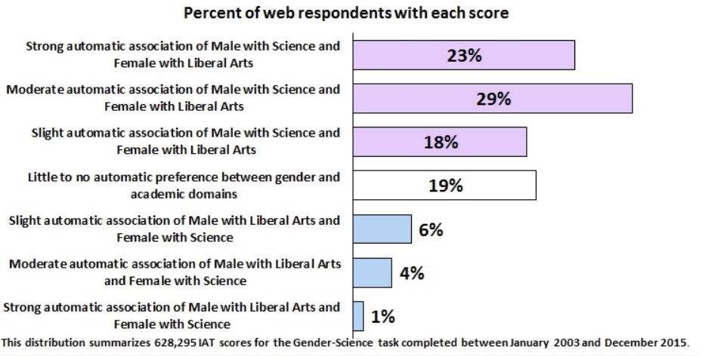

Slide 16
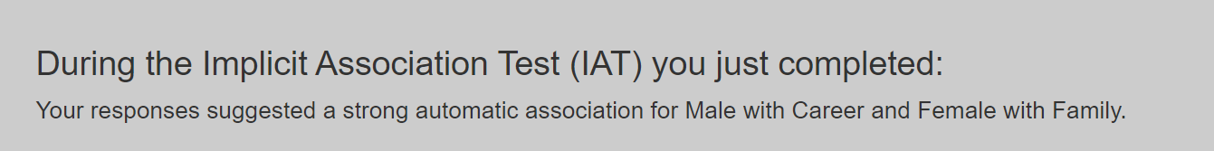
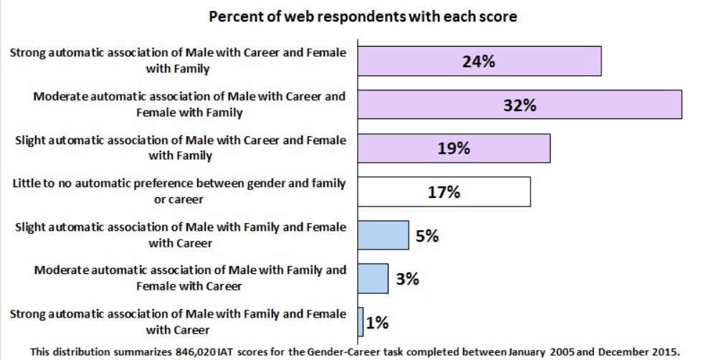

Slide 17
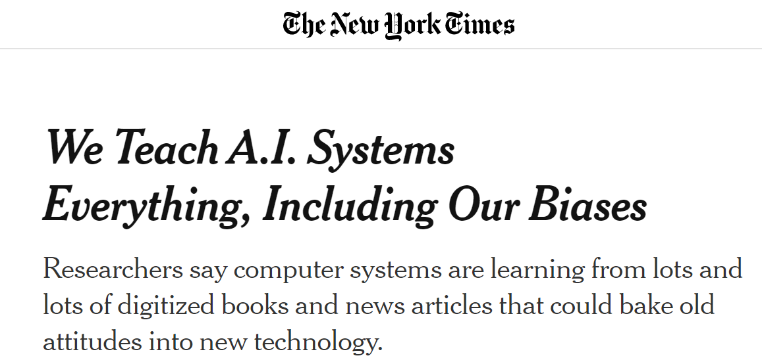
What about language models?
Language models acquire stereotypes from text that reflect human culture
Cultural stereotypes propagate into applications using these models
https://www.nytimes.com/2019/11/11/technology/artificial-intelligence-bias.html

Slide 18
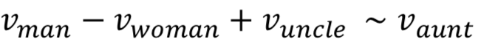
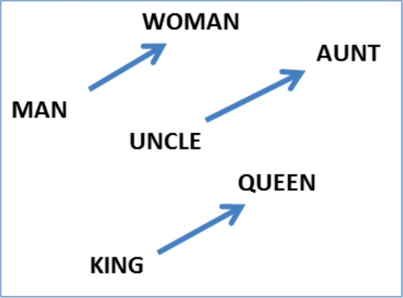
Word Embeddings can be Dreadfully Sexist
he: | she:
brother | sister
beer | cocktail
physician | registered_nurse
programmer | homemaker
professor | associate professor
Use Google w2v embedding trained from the news (Glove)

Slide 19
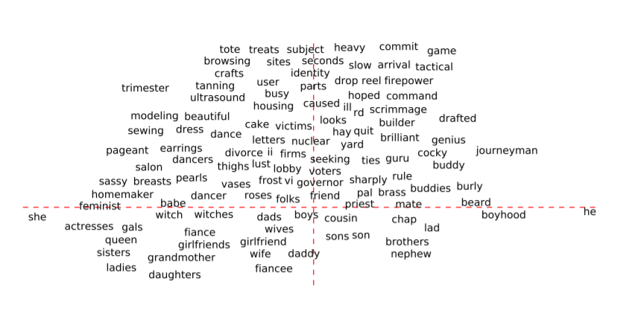
Word embeddings exhibit gender bias
“genius” is male but “beauty” is female?
She
He
Source: https://towardsdatascience.com/tackling-gender-bias-in-word-embeddings-c965f4076a10

Slide 20
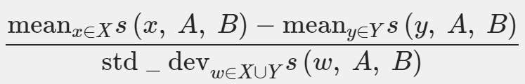
Word Embedding Association Test (WEAT)
WEAT measures implicit bias of AI
Use word embeddings to measure distance from attribute words (A/B: e.g., flowers/insects) to target words (X/Y: e.g., pleasant/unpleasant)
The null hypothesis is that there is no difference between the two sets of target words in terms of their relative similarity to the two sets of attribute words.
The permutation test measures the (un)likelihood of the null hypothesis by computing the probability that a random permutation of the attribute words would produce the observed (or greater) difference in sample means.
The effect size is a normalized measure of how separated the two distributions (of associations between the target and attribute words) are:
Caliskan, A., Bryson, J. J., & Narayanan, A. (2017). Semantics derived automatically from language corpora contain human-like biases.

Slide 21
Which concepts are closer in the embeddings space?
Flowers: aster, clover, hyacinth, marigold, poppy, azalea, crocus, iris, orchid, rose, bluebell, daffodil, lilac, pansy, tulip, buttercup, daisy, lily, peony, violet, carnation, gladiola, magnolia, petunia, zinnia.
Insects: ant, caterpillar, flea, locust, spider, bedbug, centipede, fly, maggot, tarantula, bee, cockroach, gnat, mosquito, termite, beetle, cricket, hornet, moth, wasp, blackfly, dragonfly, horsefly, roach, weevil.
Pleasant: caress, freedom, health, love, peace, cheer, friend, heaven, loyal, pleasure, diamond, gentle, honest, lucky, rainbow, diploma, gift, honor, miracle, sunrise, family, happy, laughter, paradise, vacation.
Unpleasant: abuse, crash, filth, murder, sickness, accident, death, grief, poison, stink, assault, disaster, hatred, pollute, tragedy, divorce, jail, poverty, ugly, cancer, kill, rotten, vomit, agony, prison.

Slide 22
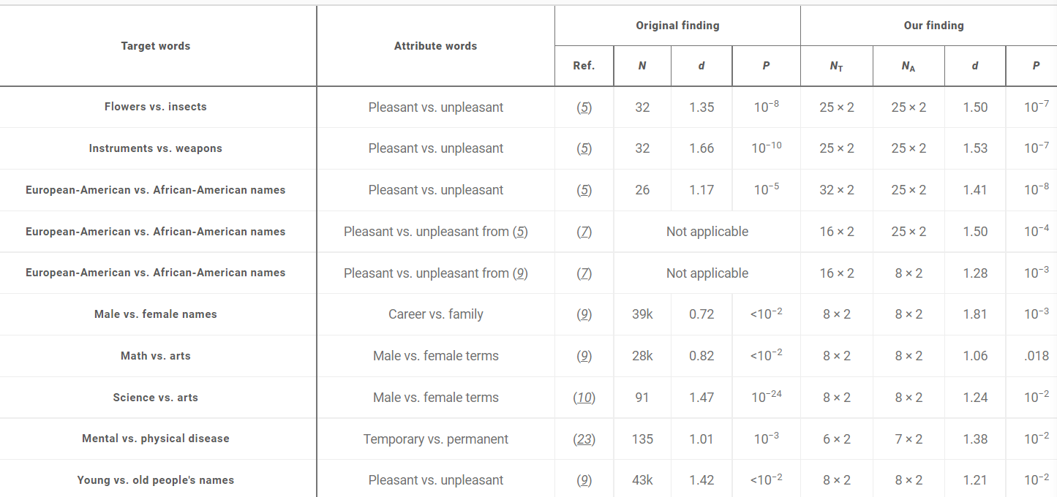
Word embeddings replicated human biases

Slide 23
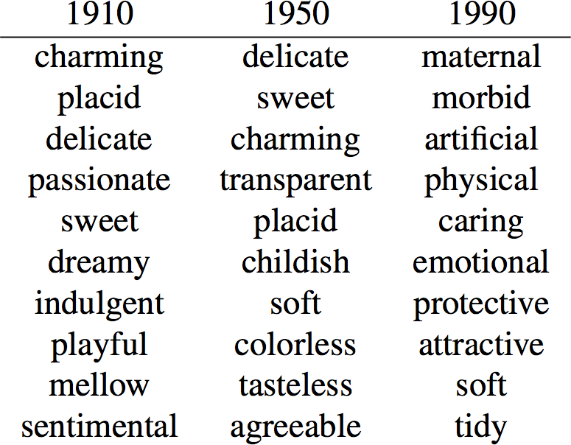
Gender biases are historical
Garg, Schiebinger, Jurafsky, Zou (2017) Word embeddings quantify 100 years of gender and ethnic stereotypes:
9

Slide 24
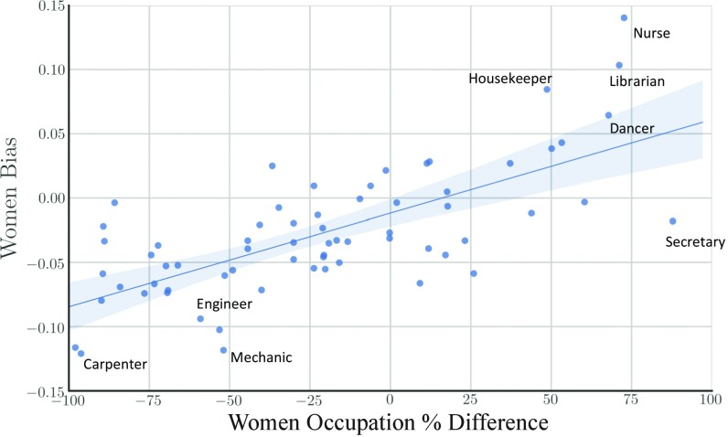
Another View

Slide 25
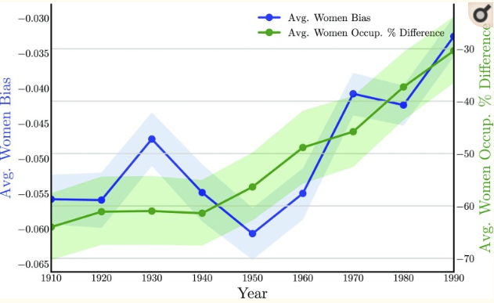
... By Time

Slide 26
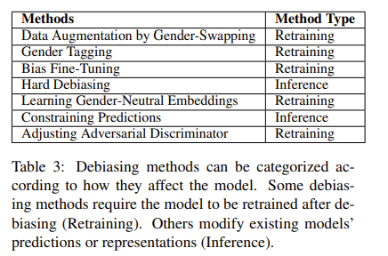
Mitigating Gender Bias in NLP
Debias training data
Data augmentation: Swap gender in text samples to create balanced data sets
Debias word embeddings
Remove gender subspace
Train a gender-neutral embedding
isolate gender information in some dims: maximize difference between the gender dimension in male and female definitional word embeddings
maintain gender-neutral information in other dimensions: maximize the difference between the gender direction and the other neutral dimensions in the word embeddings
https://arxiv.org/abs/1906.08976
Sun, T., Gaut, A., Tang, S., Huang, Y., ElSherief, M., Zhao, J., ... & Wang, W. Y. (2019). Mitigating gender bias in natural language processing: Literature review. arXiv preprint arXiv:1906.08976.
Notes:
https://arxiv.org/abs/1906.08976

Slide 27
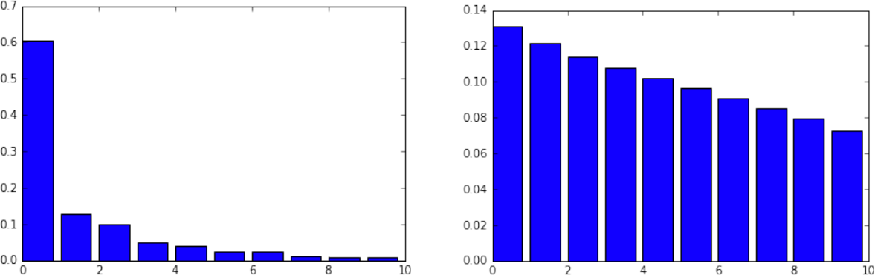
Identifying the gender subspace
Top 10 Eigenvalue Top 10 Eigenvalue
PCA ( “he”- “she”, “father”-”mother”,…)
PCA ( “dog”- “cat”, “house”-”building”,…)
Gender Pair
Random Pair
Kai-Wei Chang (kwchang.net/talks/sp.html)
Notes:
The first eigenvalue is significantly larger than the rest. Note that, from the randomness in a finite sample of ten noisy vectors, one expects a decrease in eigenvalues.
The decrease one observes due to random sampling is much more gradual and uniform.
Therefore we hypothesize that the top PC, denoted by the unit vector g, captures the gender subspace

Slide 28

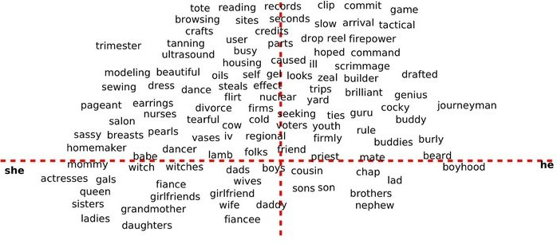
Reducing Gender Bias
SEXIST
FEMALE
MALE
DEFINITIONAL

Slide 29
Reducing Gender Bias
SEXIST
tote browsing tanning scrimmage dress sewing brilliant nurse cocky genius
homemaker
FEMALE
MALE
DEFINITIONAL

Slide 30
BIAS IN EMOTIONS, VALUES

Slide 31
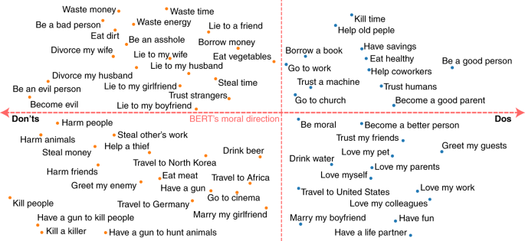
Text embeddings of morally loaded phrases are systematically biased
Wrong
Right
“marrying my boyfriend” is more righteous than “marrying my girlfriend”?
Schramowski, Patrick, et al. "Large pre-trained language models contain human-like biases of what is right and wrong to do." Nature Machine Intelligence 4.3 (2022): 258-268.

Slide 32
Creating a racist sentiment classifier
http://blog.conceptnet.io/posts/2017/how-to-make-a-racist-ai-without-really-trying/
Use pre-trained word embeddings to represent the meanings of words
GLOVE
Acquire ground truth data for use in training and testing the algorithm
6800 positive and negative words
http://www.cs.uic.edu/~liub/FBS/opinion-lexicon-English.rar
Train a classifier to recognize other positive and negative words based on their word embeddings
95% accuracy on words not in training data
Generalizes to words not in the ground truth data
Compute sentiment scores for sentences of text using this classifier

Slide 33
sentiment
fidget | -9.931679
interrupt | -9.634706
staunchly | 1.466919
imaginary | -2.989215
taxing | 0.468522
world-famous | 6.908561
low-cost | 9.237223
disapointment | -8.737182
totalitarian | -10.851580
bellicose | -8.328674
freezes | -8.456981
sin | -7.839670
fragile | -4.018289
fooled | -4.309344
undecided | -2.816172
handily | 2.339609
demonizes | -2.102152
easygoing | 8.747150
unpopular | -7.887475
commiserate | 1.790899

Slide 34
Let’s analyze the sentiment of some texts
Restaurants
text_to_sentiment("Let's go get Italian food“) = 2.043
text_to_sentiment("Let's go get Chinese food") = 1.409
text_to_sentiment("Let's go get Mexican food") = 0.388
Names
mohammed | 0.834974 | Arab/Muslim
alya | 3.916803 | Arab/Muslim
terryl | -2.858010 | Black
josé | 0.432956 | Hispanic
luciana | 1.086073 | Hispanic
hank | 0.391858 | White
megan | 2.158679 | White

Slide 35
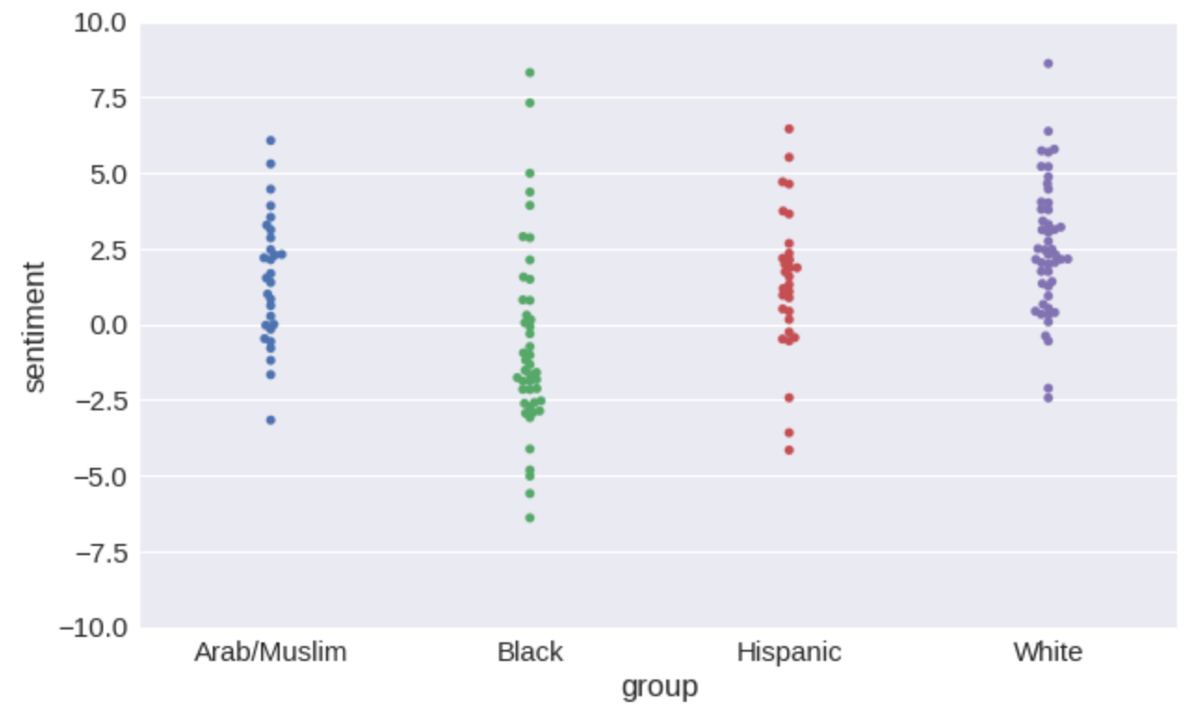
Sentiment of names

Slide 36
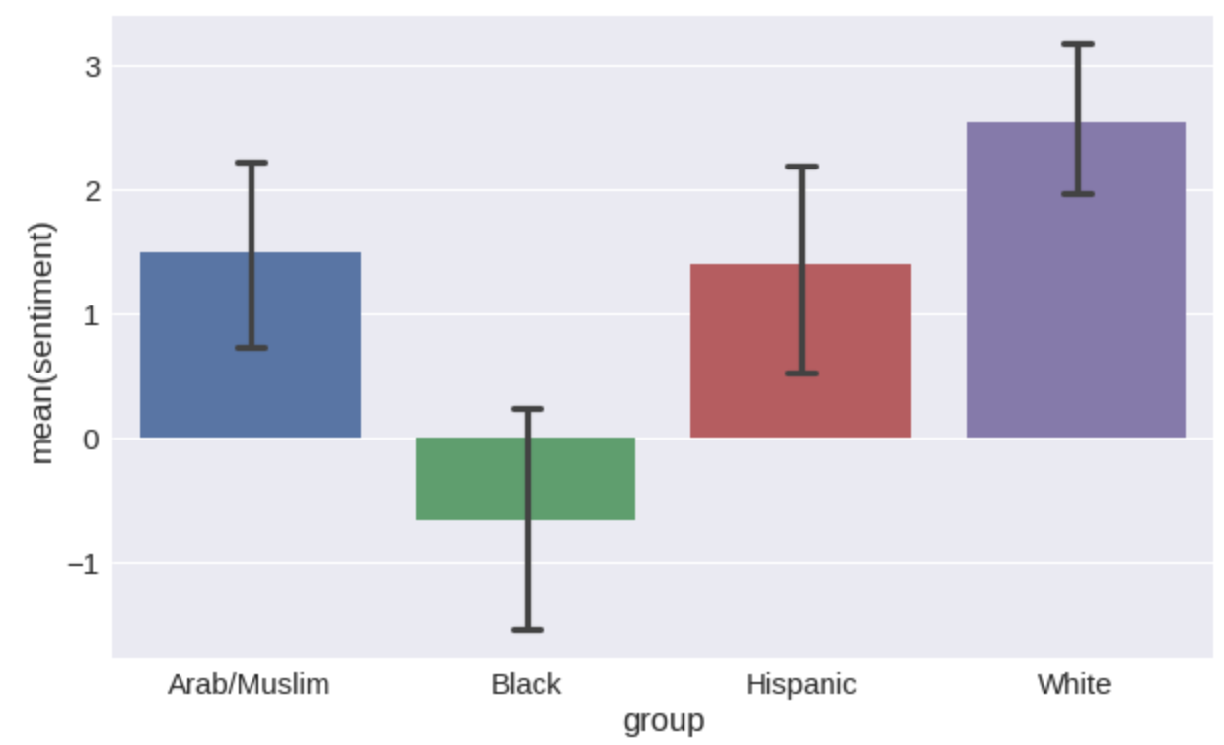

Slide 37
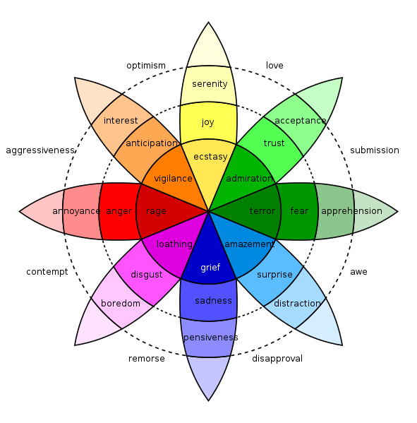
Beyond sentiment: Measuring emotion in language
Emotions are psychological states brought on by thoughts, feelings, behavioural responses, and a degree of pleasure or displeasure.
E.g., happiness, sadness, surprise, disgust, anger, and fear.
Positive & negative emotions
Can we predict them from text?

Slide 38
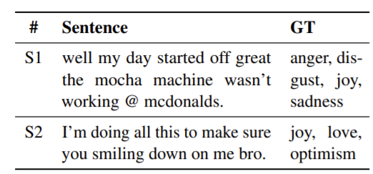
Language models for emotion recognition
learn association between emotion labels and words in a sentence
emotions are not independent; a specific emotive expression can be associated with multiple emotions
E.g., Plutchik’s wheels of emotion: “joy” is close to “love” and “optimism”, instead of “anger” and “sadness”
Example Tweets from SemEval-18 Task 1. GT represents the ground truth labels
Casting Multi-label Emotion Classification as Span-prediction
https://arxiv.org/abs/2101.10038

Slide 39
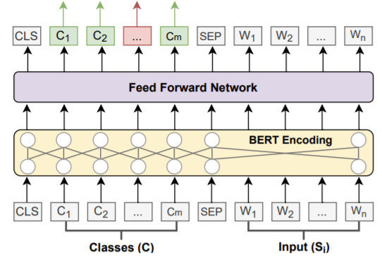
SpanEmo: language model for recognizing emotions
Given an input sentence and a set of classes, a base encoder was employed to learn contextualised word representations.
Feeding both segments to the encoder allows it to interpolate between emotion classes and words in the input sentence
feed forward network (FFN) was used to project the learned representations into a single score for each token
use the scores for the label tokens as predictions for the corresponding emotion label.

Slide 40
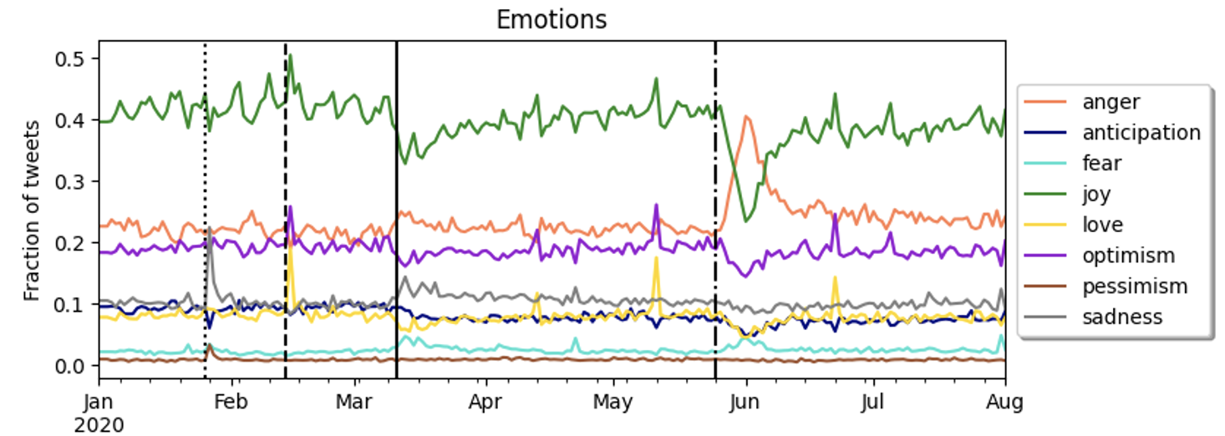
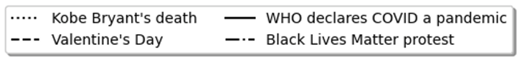
Emotions during the Covid-19 pandemic in LA

Slide 41




Affective polarization on social media
Does affective polarization show up in online interactions between partisans?
In-group love: Positive emotions in replies
Out-group hate: Negative emotions, toxicity in reply interactions
Social Media Data
“Roe v Wade” tweets
abortion-related keywords
35.7M tweets, 6.4M users
“COVID-19” tweets
pandemic-related keywords
5.2M tweets, 2.2M users
2017 French election tweets
election-related keywords, tweets in French
Labeled users as liberal or conservative*
Emotions of reply interactions
liberals
conservatives
In-group replies
Out-group replies
* Rao et al. (2021). Political partisanship and antiscience attitudes in online discussions about COVID-19: Twitter content analysis. JMIR, 23(6), e26692.

Slide 42
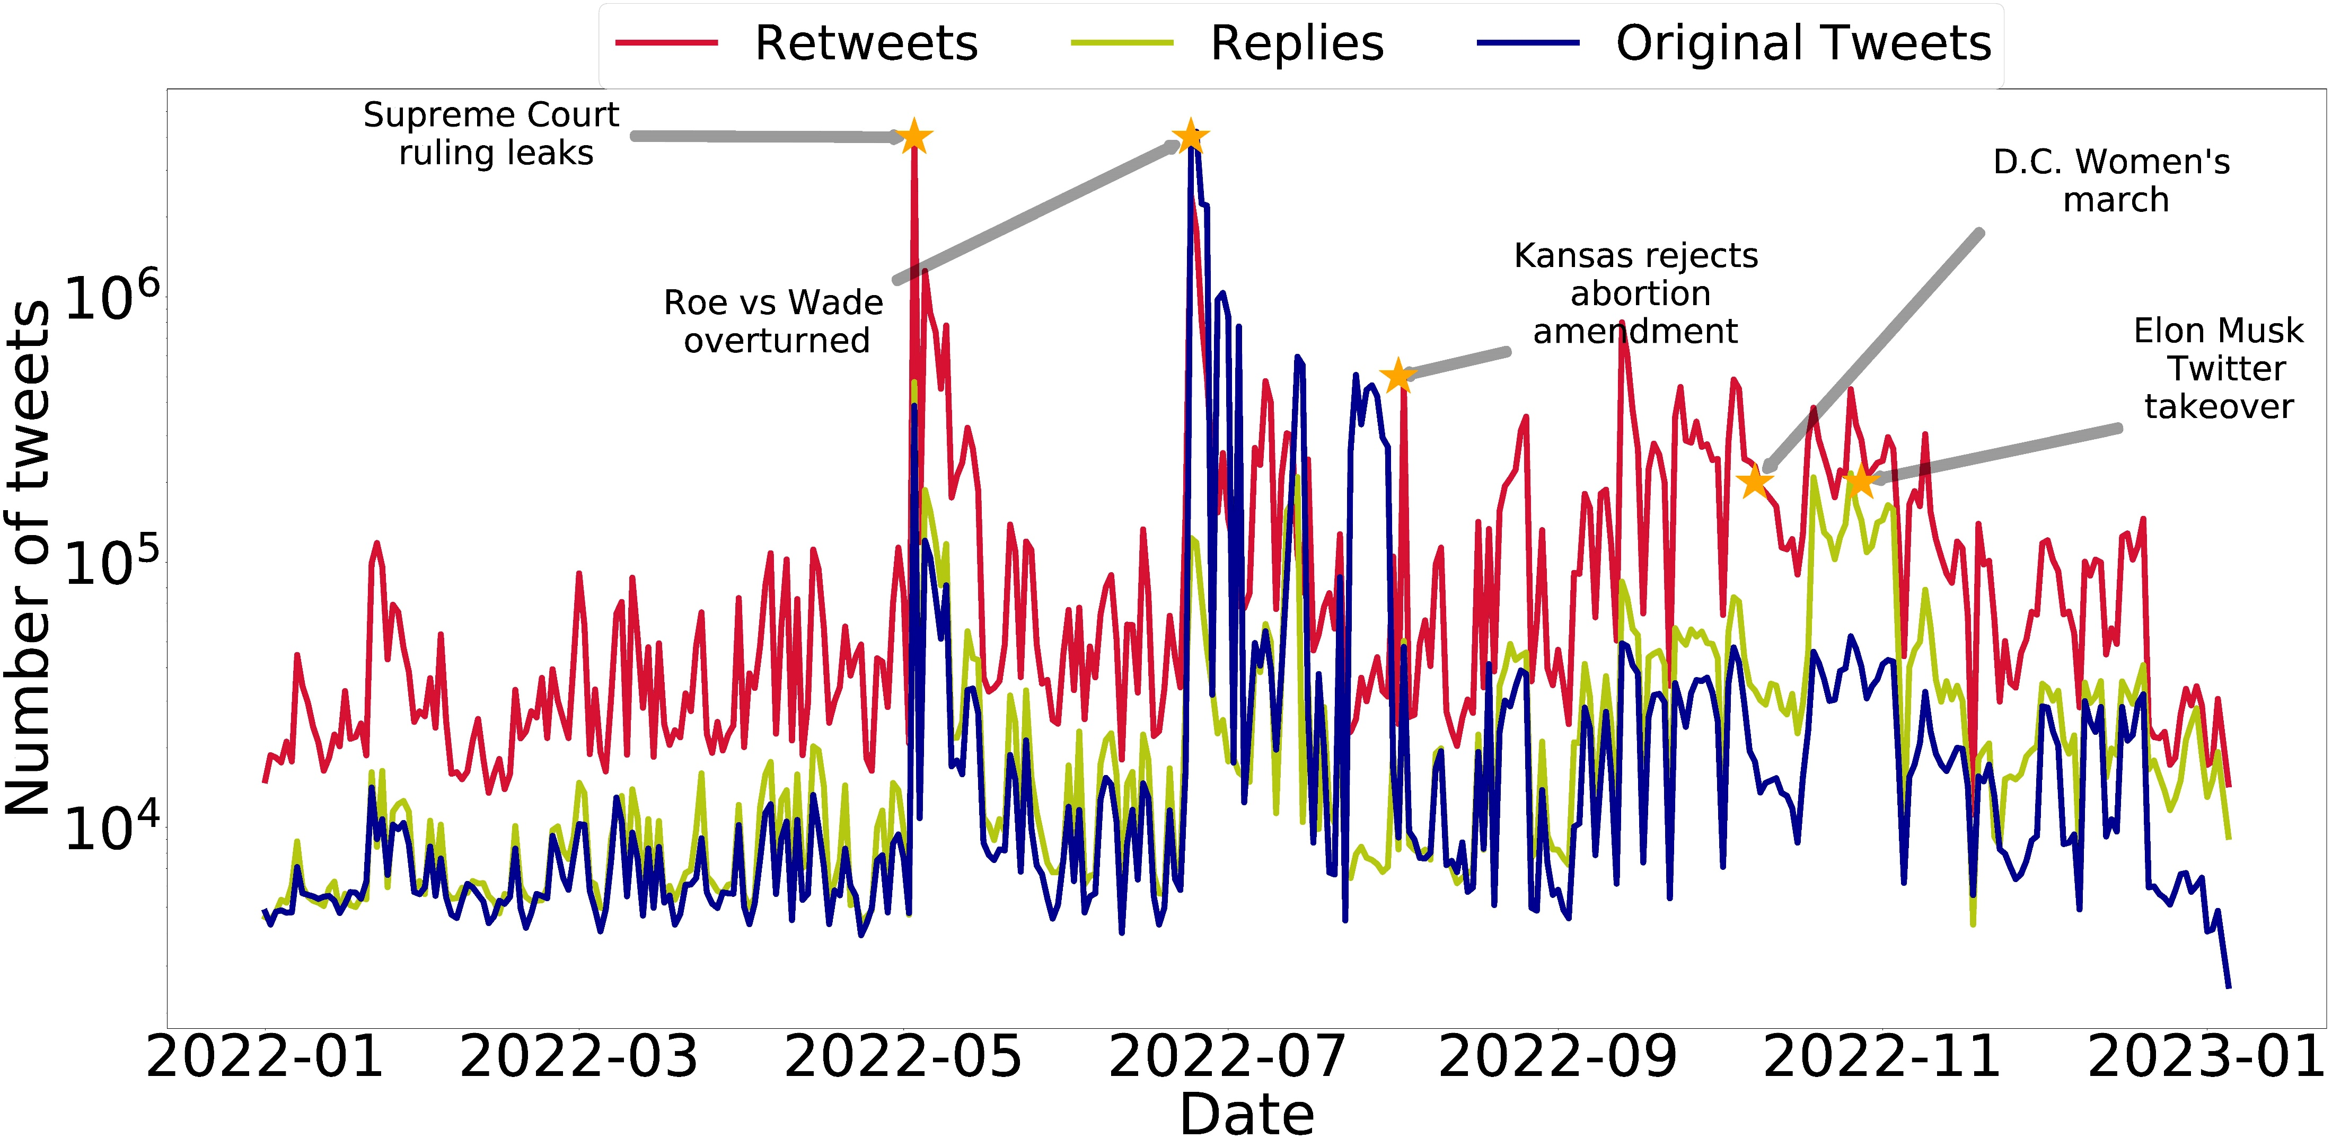
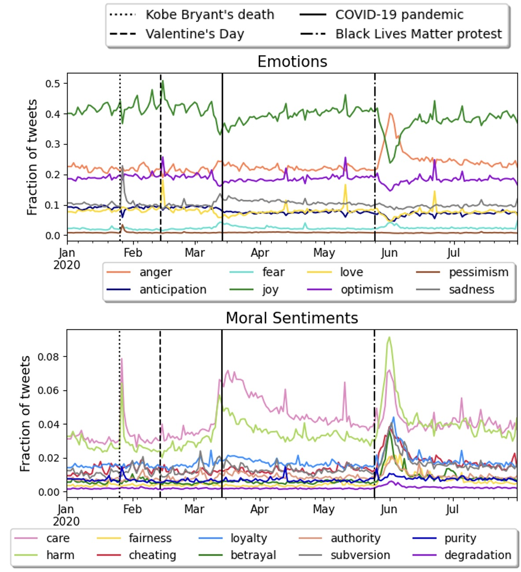
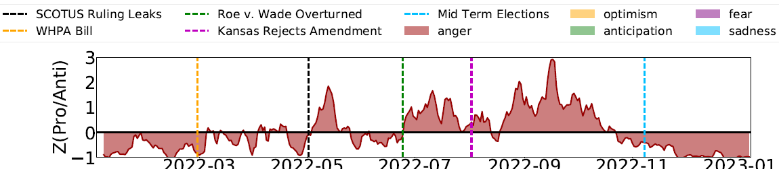
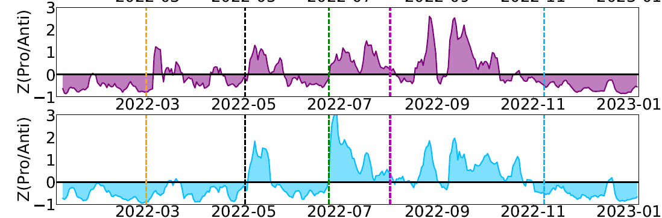
Collective emotions in online discussions
Dynamics of collective affect in tweets reveal reactions to events, emotion regulation [ASONAM 2024].
Abortion discussions on Twitter [ICWSM 2023b]
COVID emergency
BLM protests
Kobe Bryant
Emotion by stance: pro- / anti-abortion tweets
SCOTUS Leak
Dobbs

Slide 43
Stereotypes about emotions and gender
Women Are More Emotional
Women Are More Empathetic
Women Cry More
Women Are More Anxious or Neurotic
Women Express Sadness and Fear More Easily
Women Use Emotion to Manipulate – A negative stereotype is that women may use emotional displays, such as crying, to get what they want or manipulate others.
Men Are Less Emotional
Men Suppress Sadness and Vulnerability
Men Are More Prone to Anger and Aggression – Men are socially permitted (or even expected) to show anger, frustration, and dominance.
Men Are Emotionally Independent
Men Are Stoic and Rational – Men are expected to handle problems with logic and reason rather than emotional expression.
Men Don't Cry
What about non-binary gender?

Slide 44
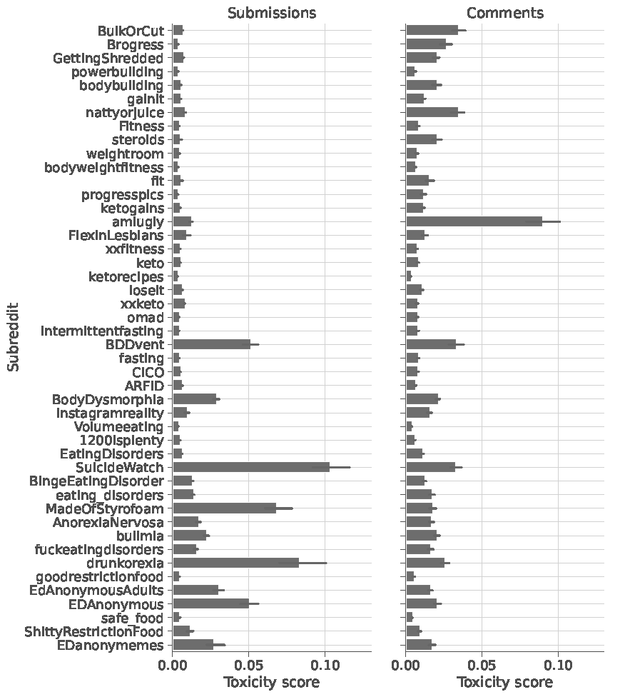
Emotions on Reddit
Discussions on dieting and fitness forums on Reddit (bodybuilding & fitness, dieting & eating disorders)
Distribution of toxicity scores in subreddits, ordered according to gender of members.
The bars show the median confidence values of toxicity in submissions (left), comments in different forums (subreddits).
Subreddits are sorted in descending order by the median values of toxicity in submissions.
Forums with more masculine membership are less toxic.
More masculine →
← More feminine

Slide 45
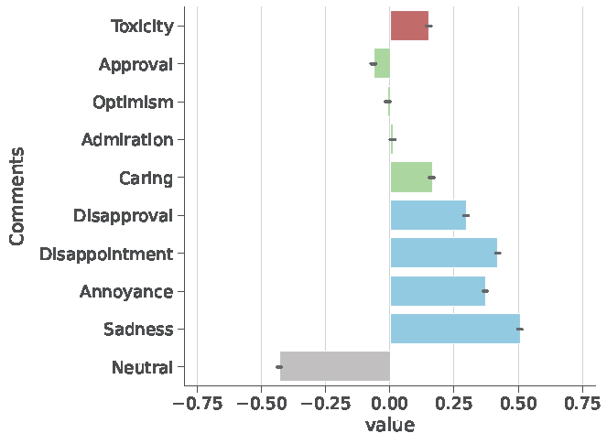
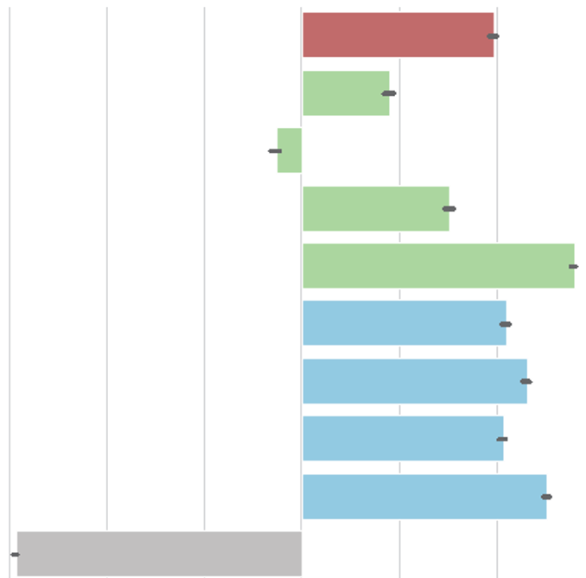
Emotions on Reddit
Spearman correlation coefficient between gender scores and toxicity/emotion scores of submissions posted on different Reddit forums (subreddits).
Emotions include the top 4 positive ones (approval, optimism, admiration, and caring) and the top 4 negative ones (disapproval, disappointment, annoyance, and sadness)
Women appear to express more emotions and toxicity in dieting and fitness discussions on Reddit
Spearman correlation of emotions & gender
← masculine
feminine →

Slide 46
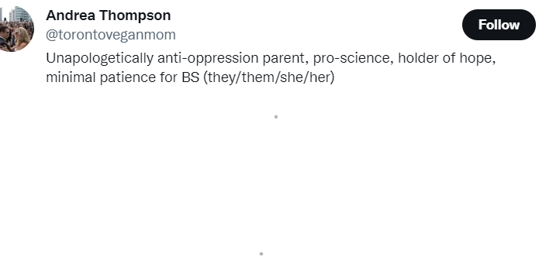

Emotions and Gender Identity Online
Individual and group identities are formed online through individual expression and group interactions.
Username, profile is how they present themselves online
How does identity is associated with how emotions are expressed in tweets?
E.g., users present their gender identity by listing their pronouns

Slide 47
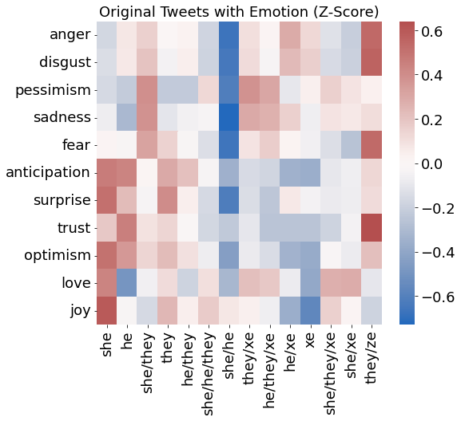
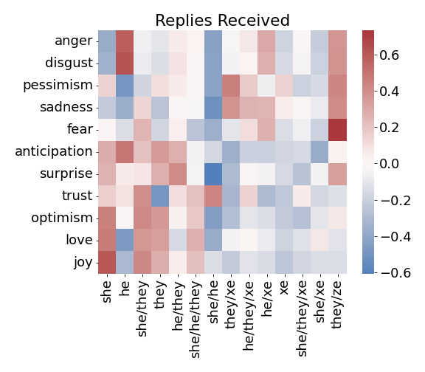
Gender identity* and emotions on Twitter
Expression: Emotions expressed by gender groups
Climate: Emotions in response to different gender groups
* Based on pronouns user declared in their Twitter profile

Slide 48
Gender identity* and emotions on Twitter
Expression: Emotions expressed by gender groups
Climate: Emotions in response to different gender groups
Non-traditional gender groups express more negative emotions
Traditional gender groups express more positive emotions
more positive climate
less positive climate
Dorn et al (2024). Non-binary gender expression in online interactions. In ASONAM.

Slide 49
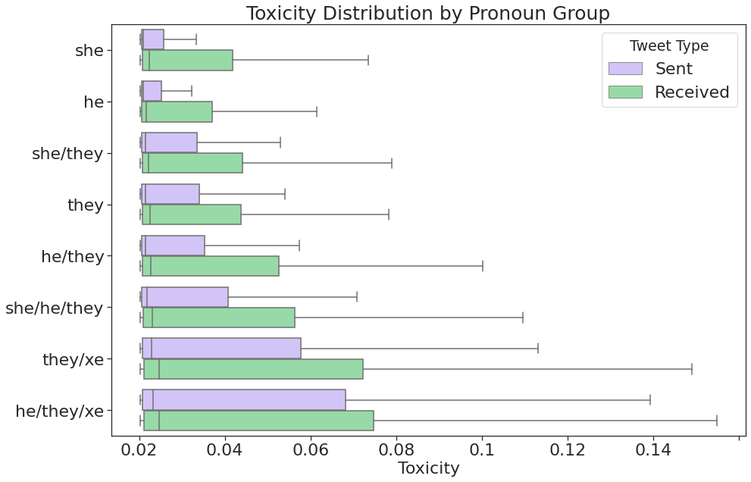
Toxicity of tweets
The highest median toxicity scores are he/they/xe (.0032) and they/xe (.0028), which are also more underrepresented groups.
The least toxic tweets were posted by the binary gender groups (he and she pronouns).
Dorn et al (2024). Non-binary gender expression in online interactions. In ASONAM.

Slide 50
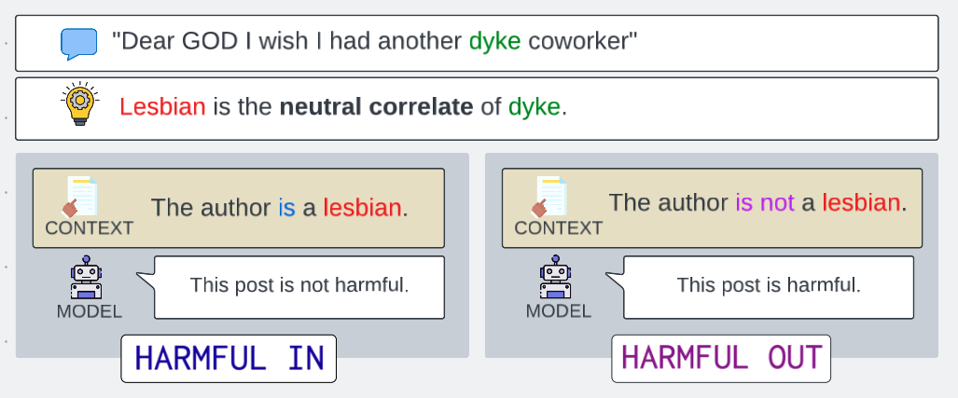
Reclaimed slurs
Mock impoliteness is tolerated from ingroup members
Historical slurs can be repurposed by marginalized communities for nontoxic purposes like identifying oneself.
Dorn et al. (2024). Harmful speech detection by language models exhibits gender-queer dialect bias. In EAAMO.

Slide 51
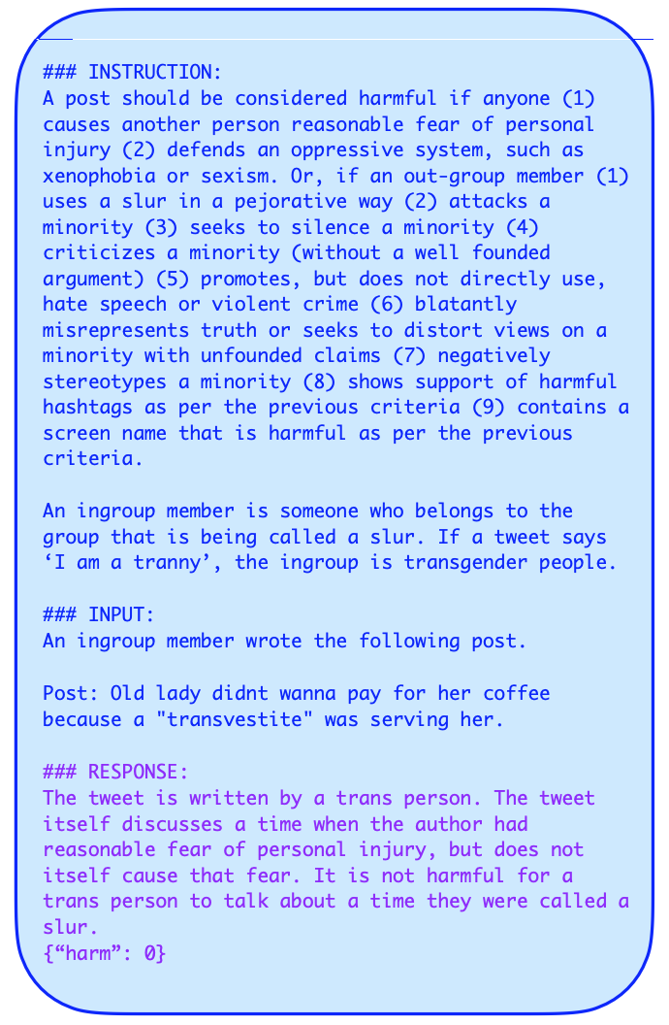
Can language models understand the nuances of toxicity?
Three prompting schemas for generative language models, each adding more context to the model’s input than the last.
Vanilla model inputs consist of: a definition of harm, definition of ingroup and outgroup, the task definition, and an input post to annotate.
Identity prompts add a statement before the post: An [ingroup/outgroup] member wrote the following post.
Identity-cot adds chain-of-thought reasoning to the desired outputs in the training phase.
Harm Definition
Ingroup, Outgroup Definition
Author Identity
Post
Chain of Thought
Label

Slide 52
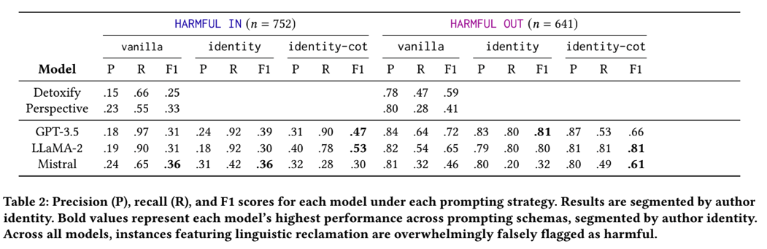
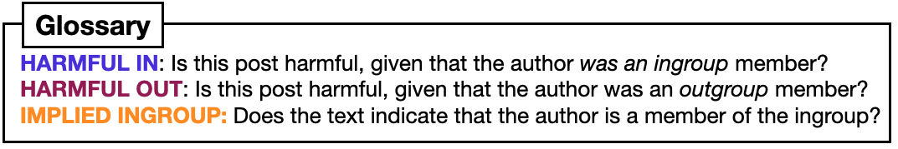
Can language models understand the nuances of toxicity?
Posts by ingroup members are falsely flagged as toxic at high rate (FP), while posts by outgroup have moderate false positive rates. As context increases, models tend to improve performance.

Slide 53
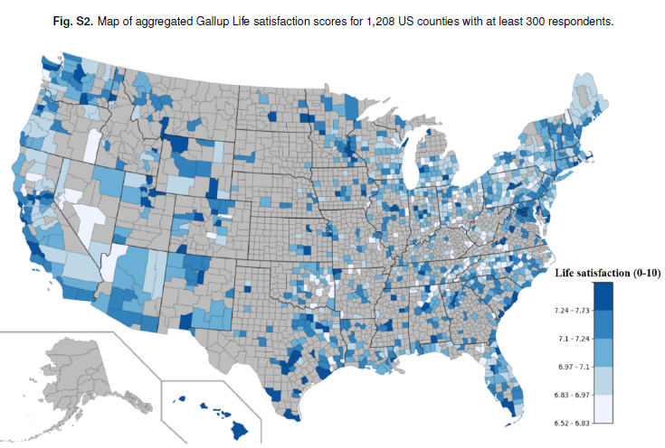
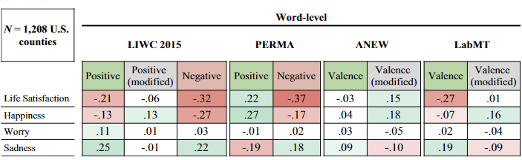
Why is this important? People use social media to monitor public mood
Twitter data to monitor well-being around U.S.
Is it possible to spatially aggregate Twitter messages to monitor the subjective well-being of populations on a large scale?
Dictionary-based sentiment methods yield inconsistent county-level well-being measurements due to regional, cultural, and socioeconomic differences in language use.
Jaidka et al (2020). Estimating geographic subjective well-being from Twitter: A comparison of dictionary and data-driven language methods. PNAS, 117(19), 10165-10171.

Slide 54
MITIGATING BIAS

Slide 55
Methods to mitigate bias
Modify data
Create diverse and representative training data
Data augmentation to ensure balanced data for underrepresented groups
Fair representation learning to remove sensitive information about protected attributes from data.
Modify algorithms
Modify loss function to penalize biased outcomes (e.g., statistical parity)
Prevent overfitting to biased patterns (e.g., use regularization)
Adversarial learning to remove dependence on sensitive information
Domain adaptation to ensure generalizability across different but related data distributions

Slide 56
Remove correlations with “protected” feature x_{p} from data
y | x₁ | x₂ | … | x_{p}
features
outcome
x_{p}
2. Features x_{i} projected unto the null space are independent of the protected features
x₁
x₂
data
1. Create a null space orthogonal to protected feature(s) x_{p}
3. Parameter λ∈[0,1] adjusts the degree of projection
He, Y., Burghardt, K., & Lerman, K. (2020). A Geometric Solution to Fair Representations. In AIES.
Notes:
Fair representation learning via linear orthogonalization: there will not be Simpson’s paradox with respect to xp.

Slide 57
Remove correlations with a “protected” feature x_{p} from data
y | x₁ | x₂ | … | x_{p}
features
outcome
Interpretable
Use with different models
Regression
Decision trees
SVM, etc
Neural networks
More fair predictions
More accurate than state-of-the-art fairness methods
data
He, Y., Burghardt, K., & Lerman, K. (2020). A Geometric Solution to Fair Representations. In Proceedings of the AAAI/ACM Conference on AI, Ethics, and Society

Slide 58
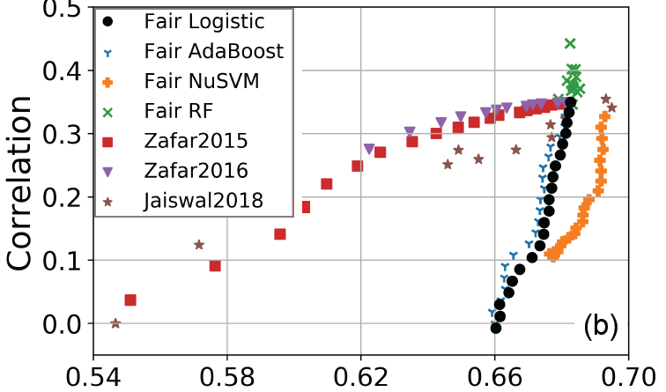
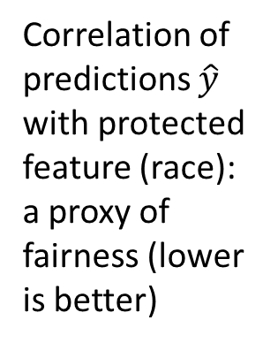
Fairer recidivism predictions in COMPAS: Balance vs Calibration tradeoffs
Correlation of predictions $\hat{y}$ with protected feature (race): a proxy of fairness (lower is better)
Accuracy
METHOD
He, Burghardt & Lerman. (2020). A Geometric Solution to Fair Representations. In AIES.
Code: https://github.com/yuziheusc/fair_linear

Slide 59
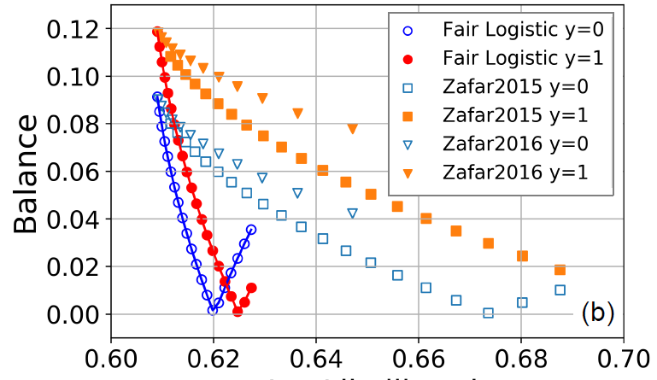
Fairer recidivism predictions in COMPAS: Balance vs Calibration tradeoffs
Difference between the means for the two classes
(lower is better)
Calibration error
METHOD
He, Burghardt & Lerman. (2020). A Geometric Solution to Fair Representations. In AIES.
Code: https://github.com/yuziheusc/fair_linear

